Slide 1

Python Programming Electric Vehicle Pricing Analysis Group 10

Slide 2
Dataset Used for this analysis
Column Name | Description | Data Type
VIN (1-10) | First 10 characters of the Vehicle Identification Number, a unique identifier for each vehicle. | String
County | County where the vehicle is registered. | String
City | City where the vehicle is registered. | String
State | State where the vehicle is registered. | String
Postal Code | Postal code of the vehicle's registration location. | String/Int
Model Year | Manufacturing year of the vehicle. | Integer
Make | Manufacturer or brand of the vehicle (e.g., Ford, Tesla). | String
Model | Specific model of the vehicle (e.g., Model S, F-150). | String
Electric Vehicle Type | Type of electric vehicle (e.g., Battery Electric Vehicle, Plug-in Hybrid). | String
Clean Alternative Fuel Vehicle (CAFV) Eligibility | Indicates whether the vehicle qualifies for clean alternative fuel incentives. | String
Electric Range | Maximum distance the vehicle can travel on a single charge (in miles). | Integer
Base MSRP | Manufacturer's suggested retail price of the vehicle in USD. | Float
Legislative District | Legislative district where the vehicle is registered. | String/Int
DOL Vehicle ID | Unique identifier assigned by the Department of Licensing (DOL). | String
Vehicle Location | Location or facility where the vehicle is typically stationed. | String
Electric Utility | Utility provider for electric vehicle charging. | String
2020 Census Tract | Census tract for demographic and geographic data as of the 2020 census. | String/Int

Slide 3




Architecture/Methodology
Data Inspection
Wrangling/ cleaning
Feature Engineering
EDA
Exploring Data Structure
Exploring Data Types
Analysing Value Distributions
Handling Missing Values
Removing Duplicates
Handling Outliers
Descriptive Statistics
Visualizations
Correlation Analysis
Identifying Outliers
Encoding
Feature selection
Feature Importance
Visualizing

Slide 4
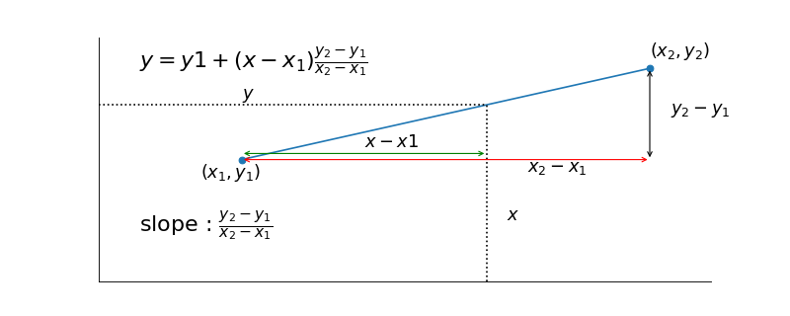
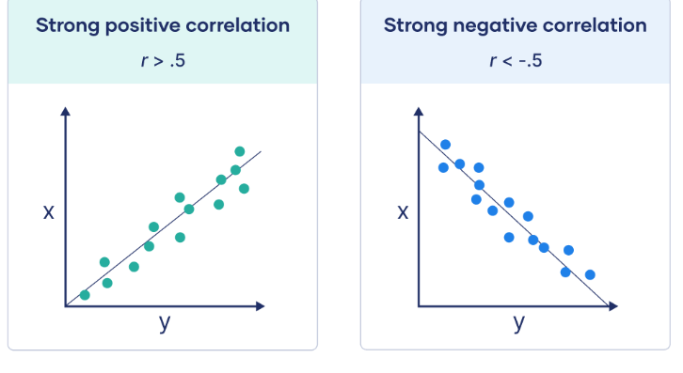
Architecture/Methodology
Interpolation (For Imputation)
Interpolation has several types, Linear interpolation is the simplest form of interpolation, connecting two known points with a straight line and estimating the values between them.
y = y₁ + (x - x₁) × [(y₂ - y₁) / (x₂ - x₁)]
Pearson Correlation
Pearson correlation is a statistical measure that quantifies the linear relationship between two continuous variables. It assesses how strongly two variables are linearly related.
r = Σ(Xᵢ - X̄)(Yᵢ - Ȳ) / [√Σ(Xᵢ - X̄)² * √Σ(Yᵢ - Ȳ)²]

Slide 5
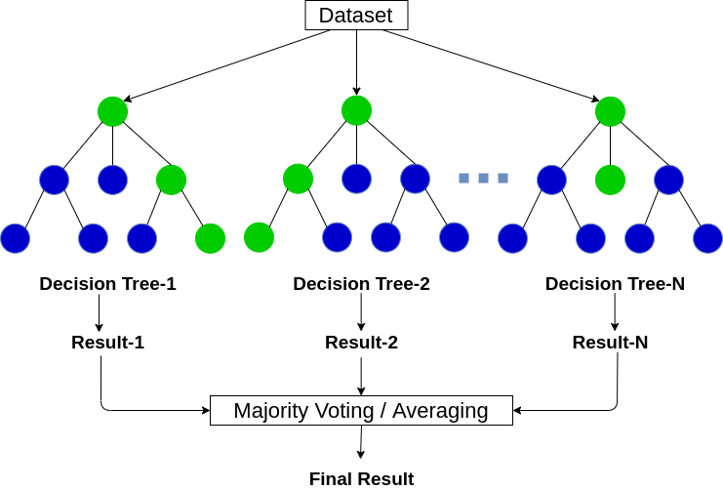
Architecture/Methodology
Random Forest
Random Forest is an ensemble of decision trees, and as it builds each tree, it assesses which features best split the data. By averaging the importance of each feature across all trees, Random Forest produces a feature importance score. This score indicates how useful each feature is in predicting the target variable. These importance scores can be used to rank features, allowing you to identify the most relevant features for the model, which helps in dimensionality reduction.
Where N is the number of trees in the forest, and fᵢ(x) represents the prediction of the i-th tree

Slide 6
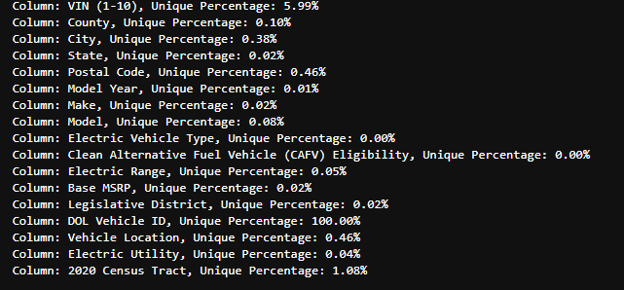
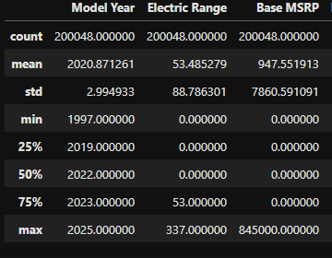
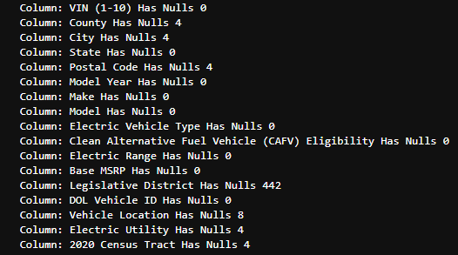
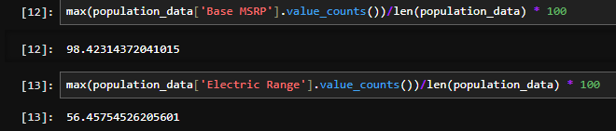
Data Inspection Insights
Insights:
The DOL Vehicle ID is the most distinctive column in the dataset.
98.4% of Base MSRP values are zero, indicating a significant imbalance.
56.45% of Electric Range values are zero, contributing to the dataset's imbalance.
The dataset description reveals that both Electric Range and Base MSRP data points are highly skewed. Addressing these imbalances is crucial, as they can distort analysis and lead to inaccurate conclusions.

Slide 7
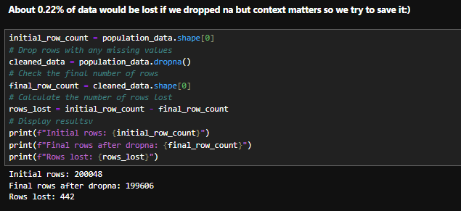
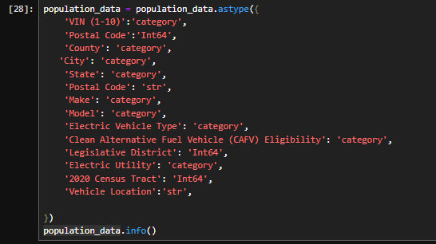
Data Cleaning – Dropping Nulls and Typecasting the dataset
Insights:
Removing NaN values results in a loss of 0.2% of the overall data.
The dataset contains no duplicate columns, leading to no drops in data points.
The dataset has been typecasted for consistency and accuracy.

Slide 8
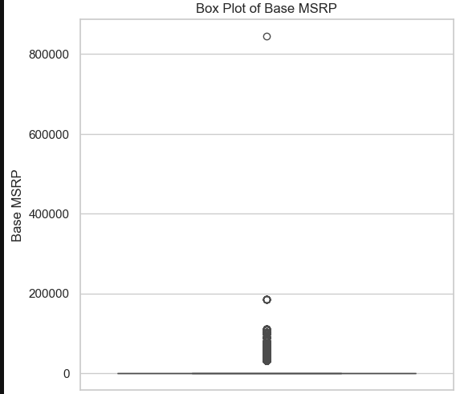
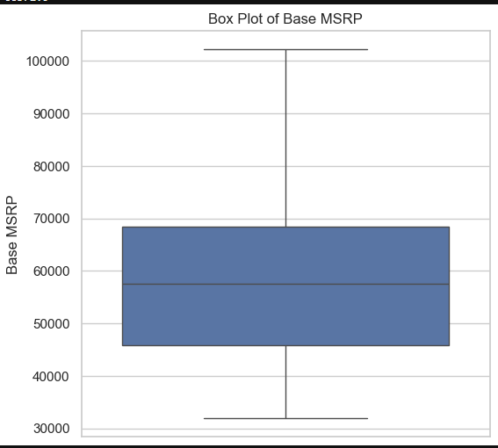
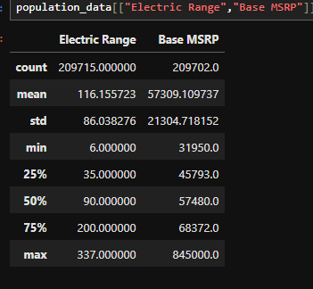
Data Cleaning – Imputation and outlier treatment on Electric Range and Base MSRP
Before Imputation and outlier treatment
After Imputation and outlier treatment
Insights:
As previously mentioned, both the electric range and Base MSRP contain a significant number of zero values. To address this issue, we have employed linear interpolation imputation for our subsequent analysis.
We have used capping and flooring for our outlier treatment of the dataset.
This approach allows us to maintain the integrity of our dataset, ensuring more accurate calculations and insights while minimizing the potential bias that could arise from excluding incomplete records.

Slide 9
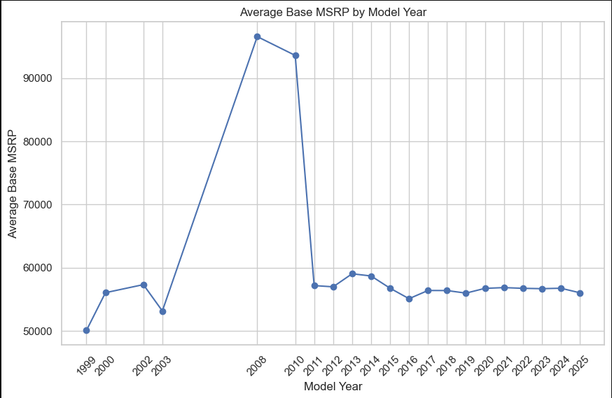
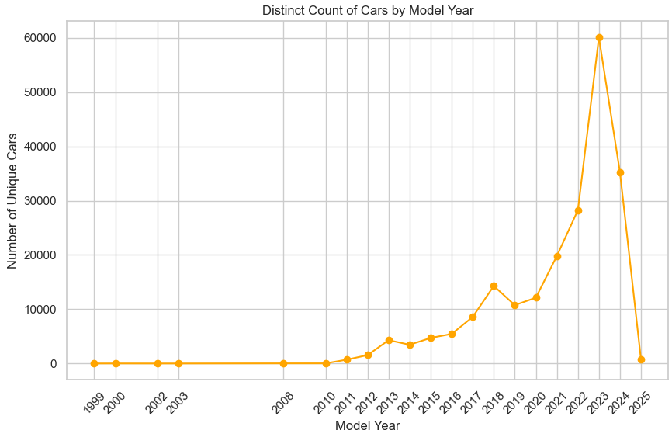
Calculate the average Base MSRP by Model Year
Insights:
There is a noticeable sharp increase in the average Base MSRP around the early 2000s and reaching a peak of $96,609.80 in 2008
Post-2010, the average Base MSRP shows stability with minor fluctuations, indicating a mature and consistent market trend
Calculate the distinct count of vehicles by Model Year
Insights:
From 1999 to around 2010, there is a relatively low and stable count of unique cars. This indicates a consistent new car models being introduced during this period and reaching a peak of 59960 in 2023.
There is a sharp decline in 2024 and 2025. This could be due to incomplete data for these years or a genuine reduction in new car model introductions, possibly caused by market saturation, economic downturn, or other industry challenges.

Slide 10
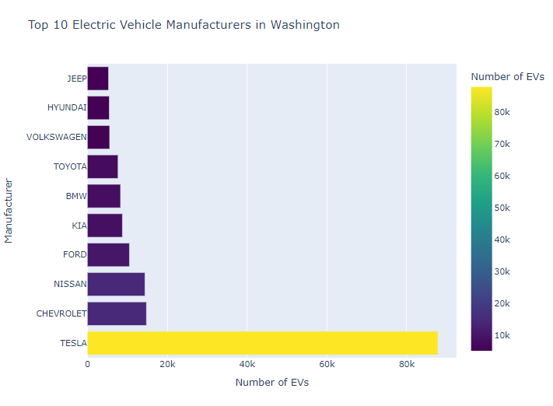
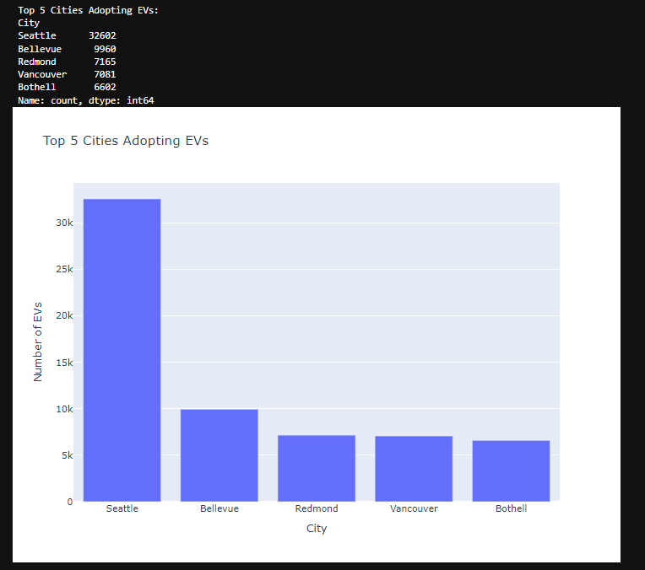
Which car manufacturers are the most commonly used for EVs in Washington?
Insights:
Tesla stands out as the clear leader with 87,860 which is 44% of the electric vehicles, accounting for a significant share of the EV market in Washington
Chevrolet (14,781) and Nissan (14,404) are closely matched for the second position
Which are the top 5 cities adopting EVs
Insights:
Seattle leads by a significant margin, indicating a strong infrastructure and support system for Evs.
Bellevue and Redmond, known for their tech-driven communities, also have high EV counts.
Vancouver and Bothell show solid adoption rates.

Slide 11
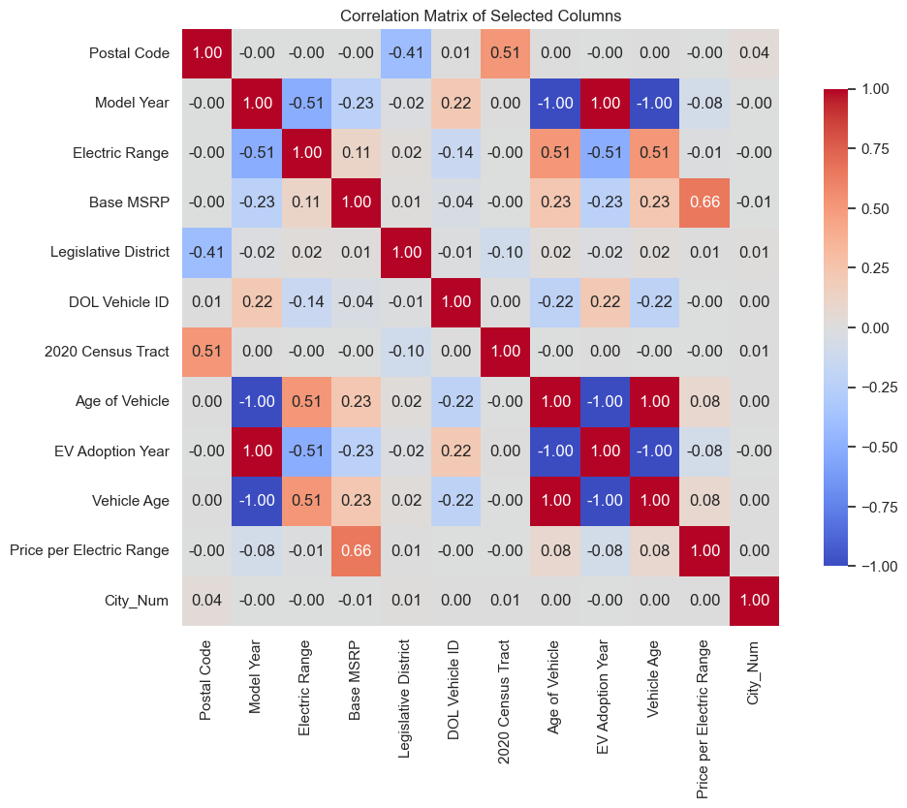
Correlation Matrix
Insights:
The moderate positive correlation between Base MSRP and Age of Vehicle (+0.23) suggests that older vehicles in this dataset may have had higher MSRPs, possibly reflecting the presence of older luxury or premium models
The strong positive correlation between Base MSRP and Price per Electric Range (+0.66) shows that higher-priced vehicles generally have a higher cost per mile of electric range. This might imply that premium vehicles offer advanced electric features or longer range, which adds to their cost

Slide 12
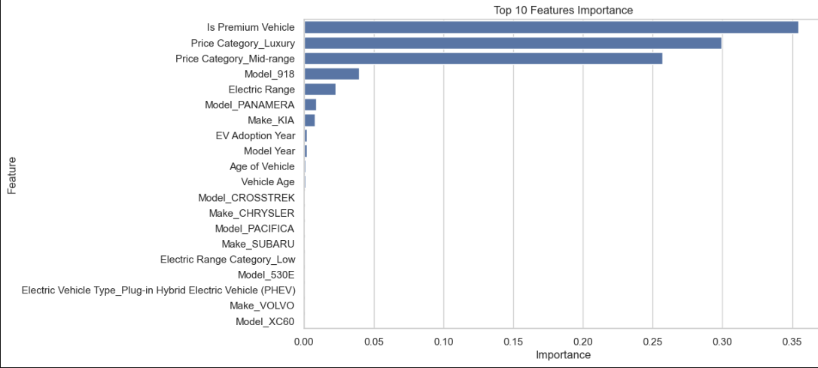
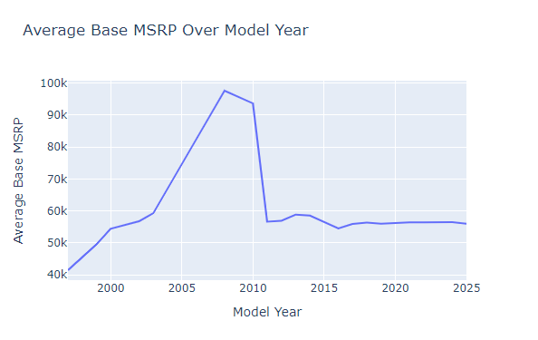
Feature Engineering for Base MSRP
Insights:
Is premium Vehicle (0.35): This is the most significant feature, implying that whether a vehicle is classified as a premium one has the greatest impact on its suggested retail price.
Price Category_Mid-range (0.29): The "Price Category" of the vehicle also plays an important role in predicting MSRP, especially if it falls into the mid-range category.
Electric Range (0.032): The electric range, or the number of miles the vehicle can travel on electric power, is another important factor, though notably less impactful than the vehicle’s classification as premium.

Slide 13
Conclusion of Electric Vehicle Pricing Analysis
Summary:
From the Feature Engineering , it is clear that is premium vehicle have the highest feature importance followed by electric range.
Implications:
For Consumers: A wide variety of choices exist, from high-end, long-range models to affordable options for budget-conscious buyers.
For Manufacturers: There is potential in the mid-range EV market for models that balance performance and price.
Future Scope:
Further analysis could explore the cost of ownership over time, including maintenance and battery longevity, to assist consumers and manufacturers in decision-making.
The Correlation matrix shows a moderate positive correlation (0.57) between price per Electric range increases , the overall price of the vehicle (Base MSRP) tends to increase as well. This relationship indicates that vehicles with higher price-per-mile ratios are generally positioned as more premium or costly models.

